Slide 1
MND SMART - Delivering innovation for definitive trials in MND
Celebrating Scottish Research Conference 2024
13th June 2024
Suvankar Pal
Professor of Neurodegenerative Disorders & Clinical Trials
University of Edinburgh

Slide 2

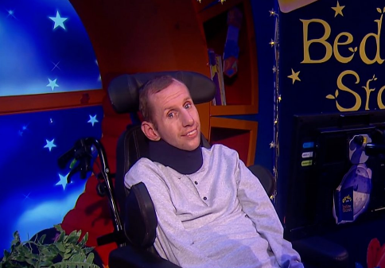
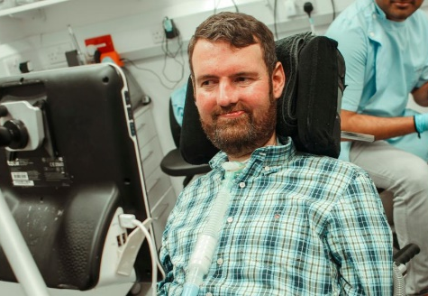
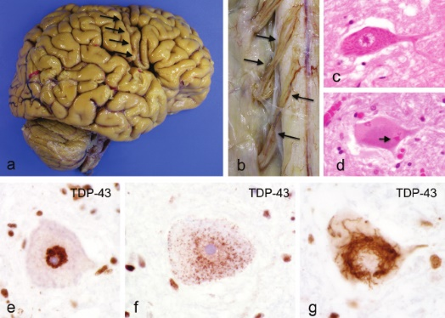
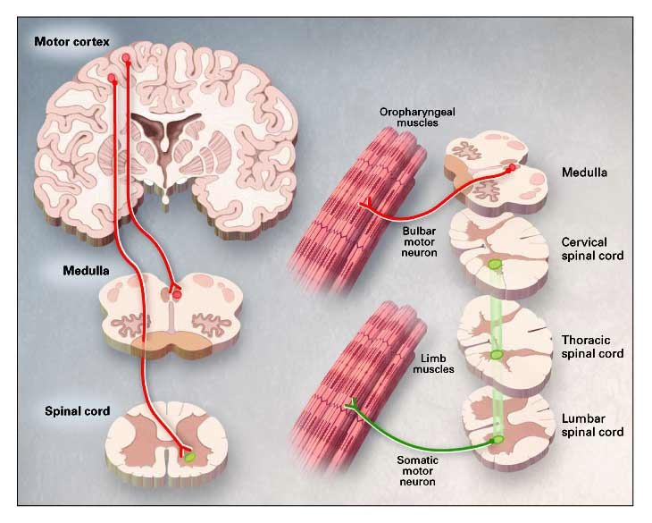
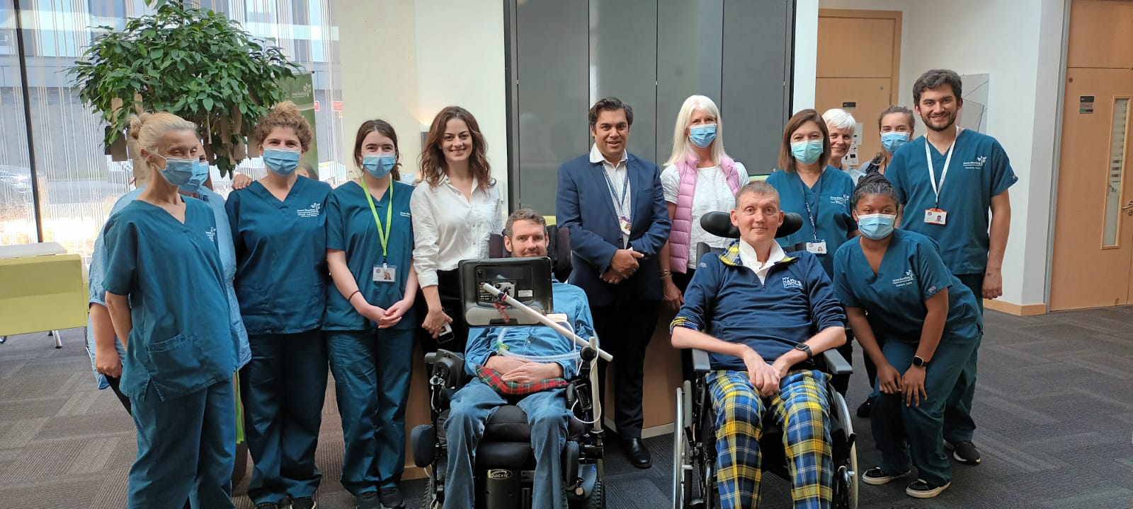
Motor neuron disease
Limb weakness, speech/swallowing, breathing difficulties
50% cognitive/behaviour change, 15% dementia
Time to reach diagnosis: 1 year
Average survival: 2-3 years, 30% die within 1 year
Lifetime risk 1:300
Affects motor cortex, spinal tracts, anterior horn cells
TDP-43 pathology in 97%
Only 1 licensed drug – 1995 – extends life by 2 months

Slide 3
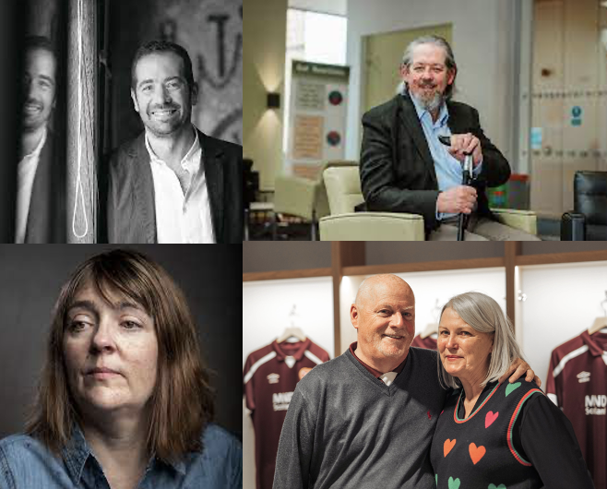
“Nothing is worse than living with MND.
We will participate in trials of any drugs that may work to slow, stop, and reverse this disease – regardless of potential side effects.”
MND SMART Patient and Public Involvement and Engagement group member, Jan 2023

Slide 4
Only 1 licensed therapy in the UK: riluzole - approved 1995
Prolongs life by 2-3 months
Over 125 trials have failed to identify new treatments
< 10% of people with MND participated in trials before 2020
Urgent need for: 1) Increased participation,
2) Innovation in drug selection, 3) Innovation in trial design

Slide 5
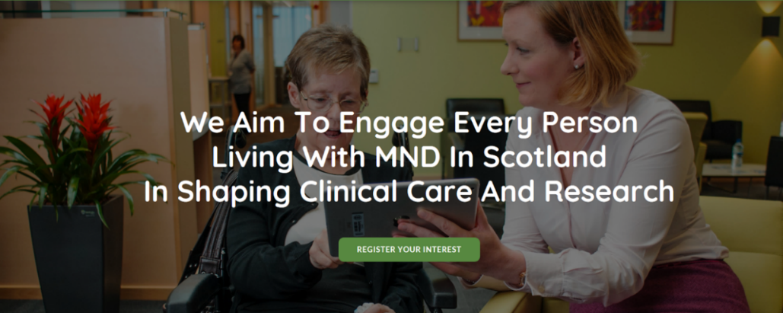
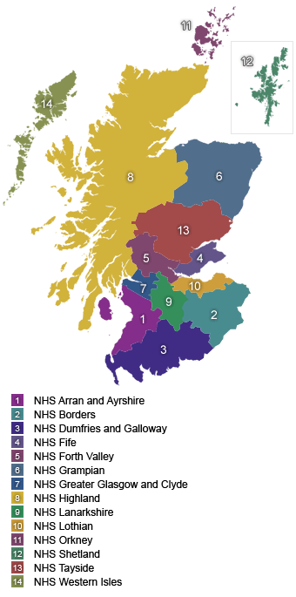
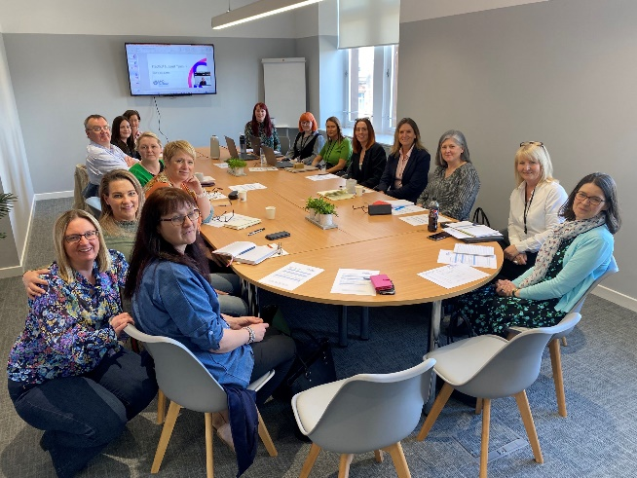



CARE-MND – A platform supporting integrated care & reverse translation
From national register to integrated comprehensive digital care and research platform
Tractable population – 5.5 million in Scotland
Unified NHS aligned with academia
Unique e-health infrastructure
1st comprehensive population-based register for MND globally
  Scottish MND Register - established 1998
  Re-launched 2015 as CARE-MND
1 nurse: 40 people with MND - recurring government investment

Slide 6
CARE-MND – A platform supporting integrated care & reverse translation
From national register to integrated comprehensive digital care and research platform
99% case ascertainment capture-recapture methodology (correlating with national death certification, hospital discharge, and riluzole prescribing data).
Comprehensive ‘real-time’ longitudinal digital clinical phenotyping benchmarked against NICE 2016 guidelines, and harmonised with other major international cohorts – secure governance
Linked bio-resourcing (DNA, serum/plasma, PBMC) + digital
Established culture (c.15% of ante-mortem consent) of autopsy

Slide 7
CARE-MND – A platform supporting integrated care & reverse translation
From national register to integrated comprehensive digital care and research platform
c.3000 pwMND - 99% case ascertainment
Detailed longitudinal clinical phenotyping from diagnosis to death
Tissue banking (DNA/plasma/serum/PBMC from >1000 pwMND)
Brain/spinal cord/CSF banking from >120 pwMND
Ongoing comprehensive monitoring of pwMND
High level of case ascertainment & patient participation
Comprehensive clinical annotation (digital data capture)
Tissue BioResources (DNA/Brain)
Delivering observational and therapeutic clinical trials

Slide 8
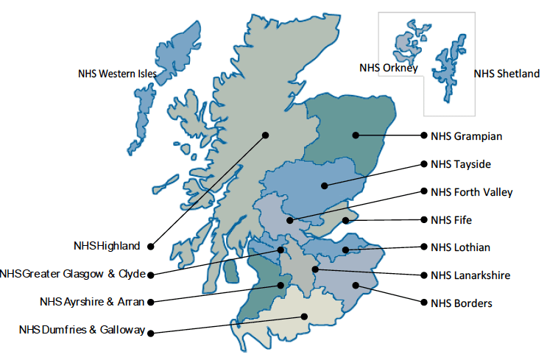
CARE-MND – A platform supporting integrated care & reverse translation
Clinical: Impact of supportive interventions, multi-morbidity, COVID-19
Epidemiology: Incidence/prevalence, genetic epidemiology, genetic risk loci
Clinicopathological correlations: cognition, polar extremes
Biomarker discovery
iPSC studies: determinants of clinical phenotype, drug screening
Digital biomarker discovery: acoustic voice data, wearables

Slide 9
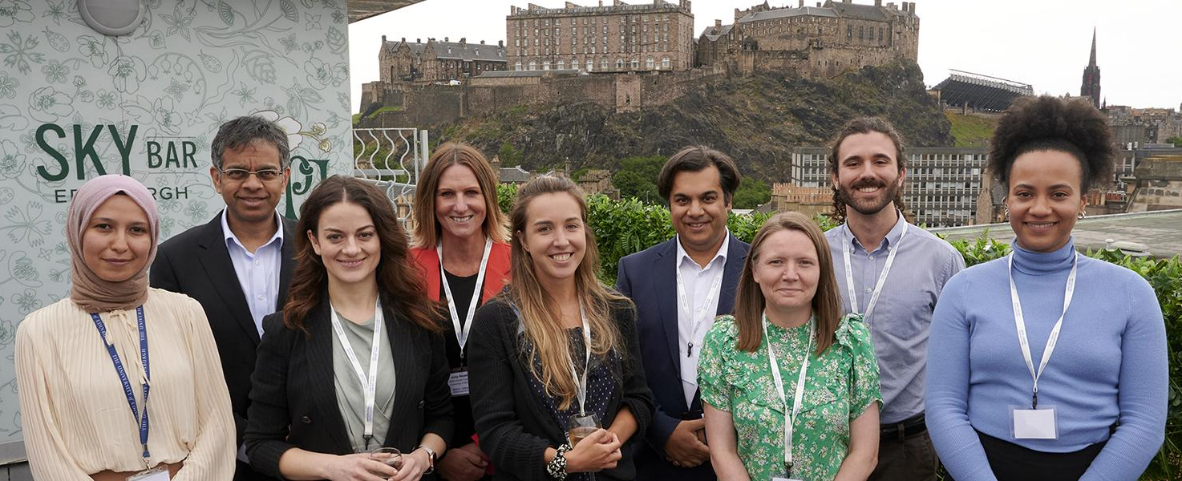
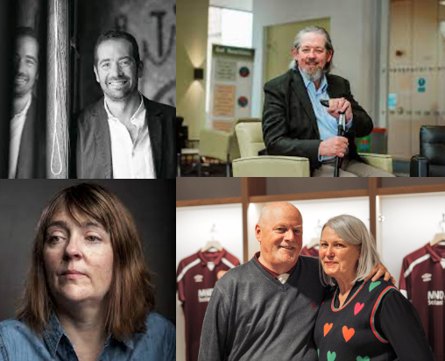
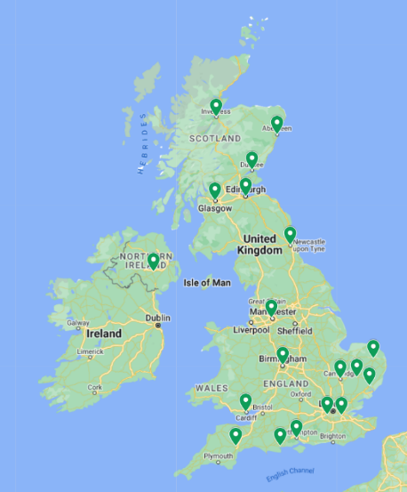
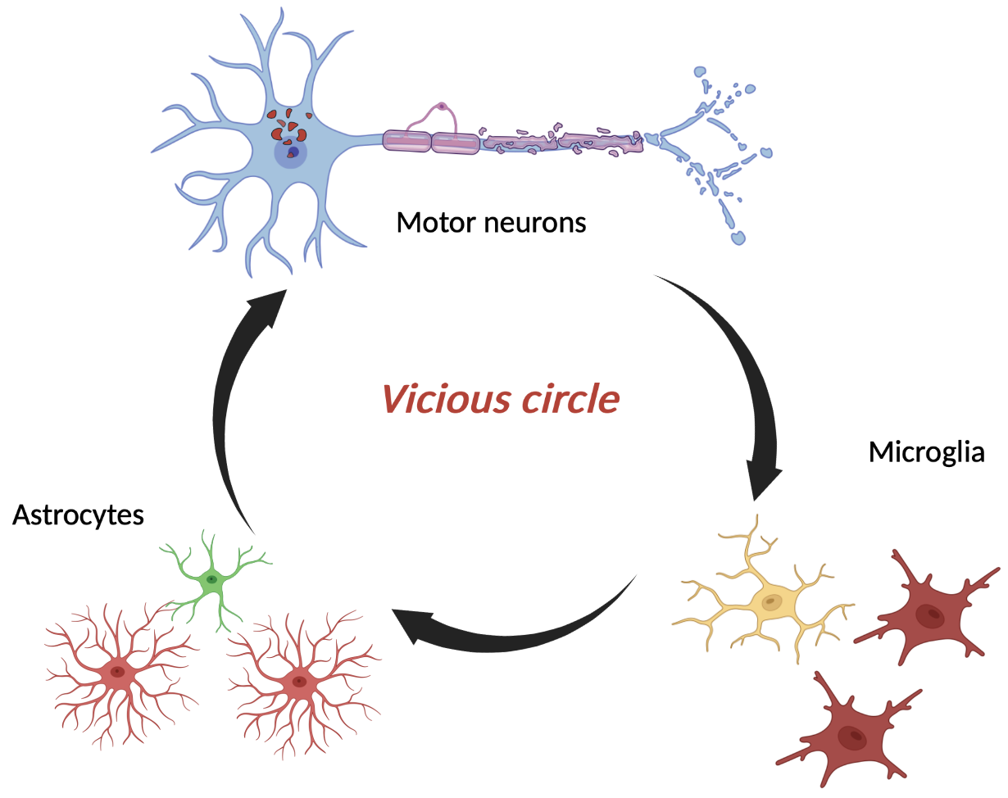
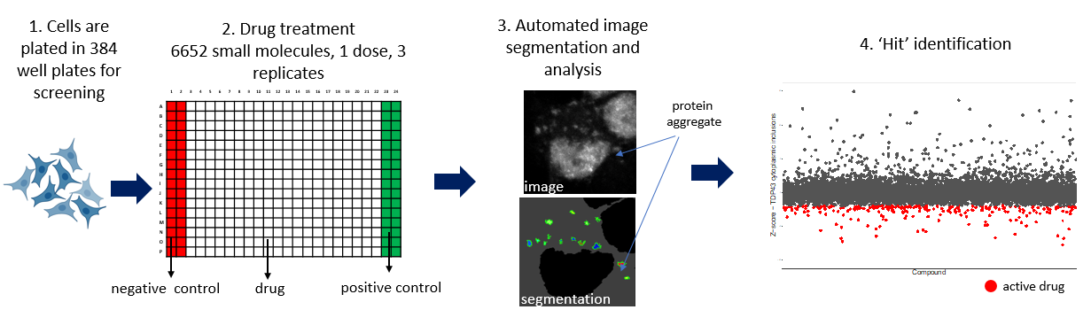
MND SMART (Systematic Multi Arm Adaptive Randomised Trial)
A UK Platform for Definitive MND TRIALS
A UK wide inter-disciplinary partnership of experts in MND disease biology, stem cells,
drug discovery, innovative trial methodology, & people living with MND

Slide 10
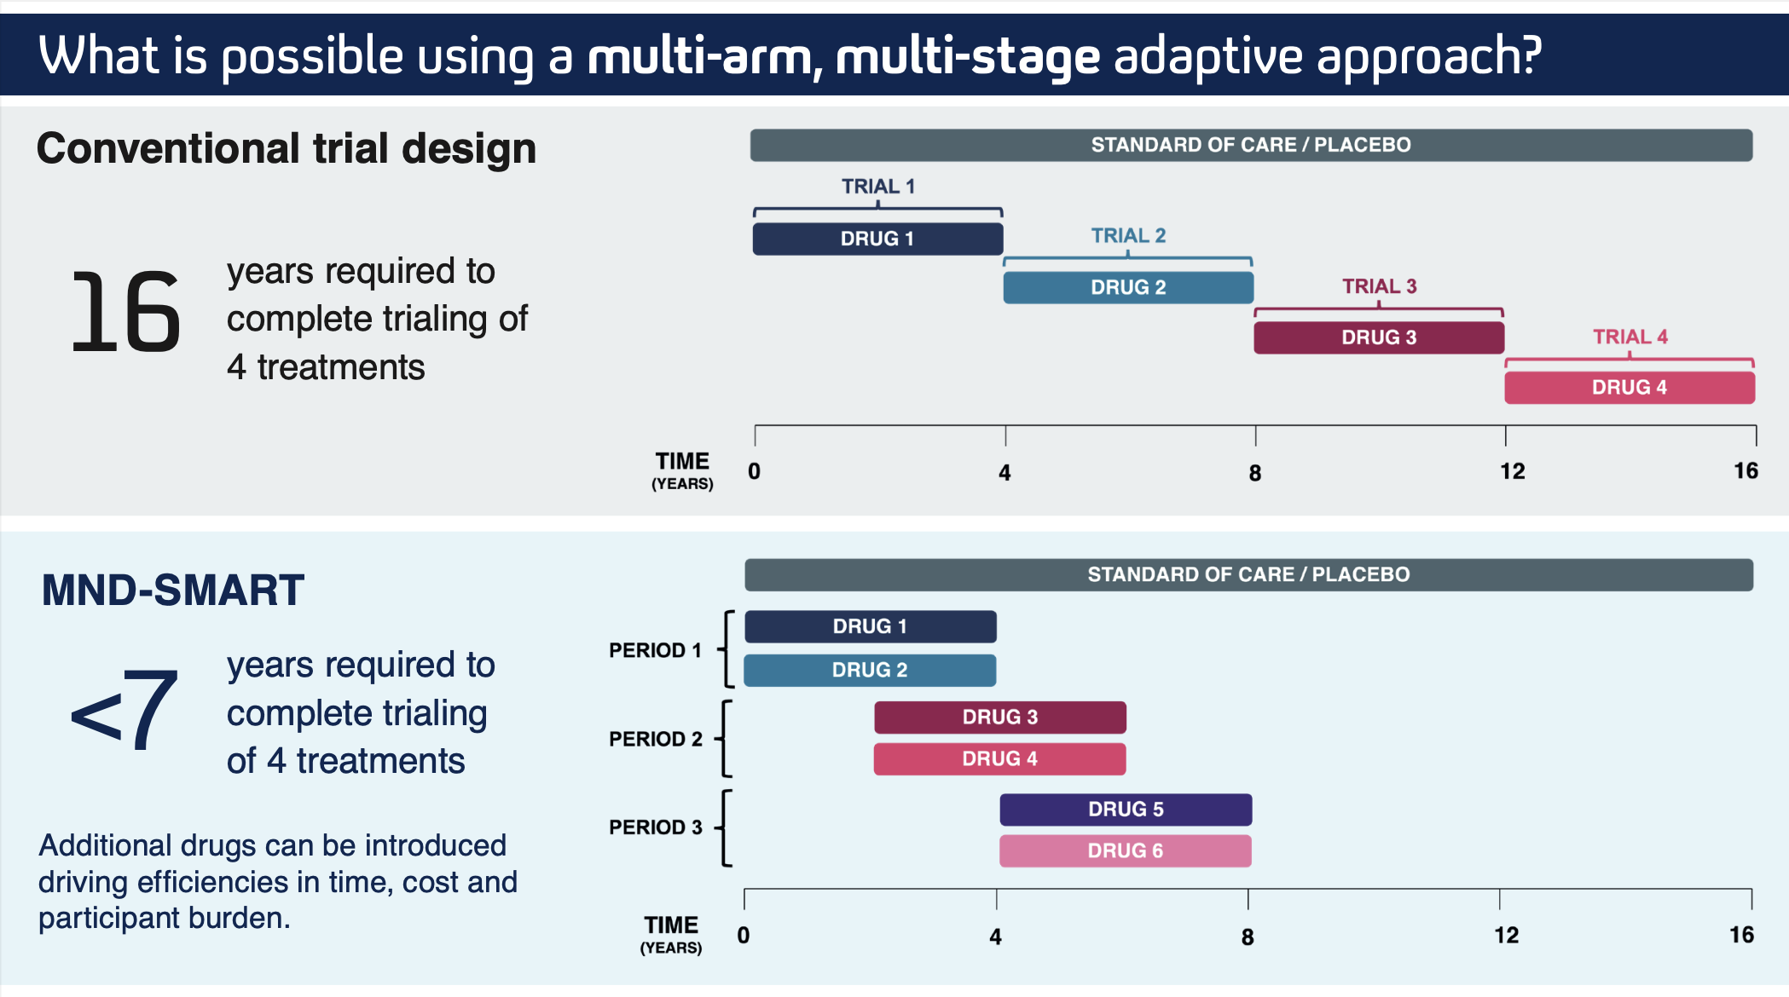

Slide 11


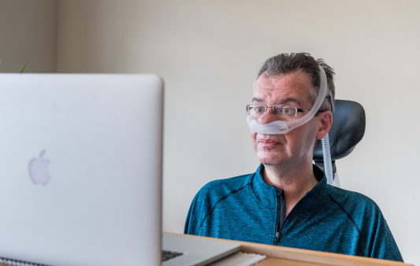
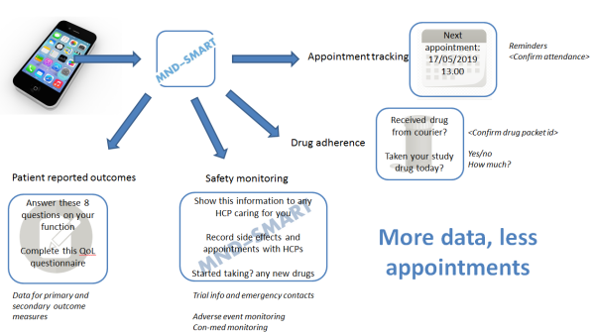
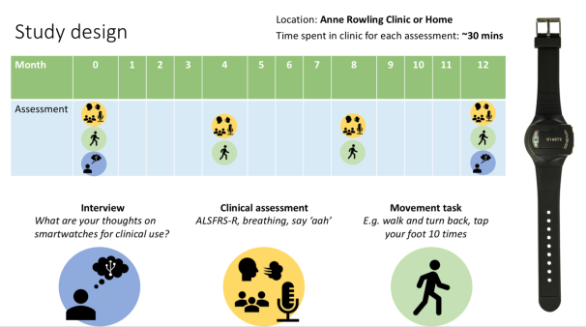
MND SMART: co-produced alongside pwMND
Open consultation/feedback from people with MND & relatives, partners, carers
Overwhelming majority of pwMND demand trials & draw comparisons with cancer
The opportunity to participate in trials should be the standard of care given current poor prognosis
Inclusive trial entry criteria
Avoid drugs in tablet form
Reduce the amount of appointments or travel to clinic for appointments
No individual with MND should have to travel past multiple hospitals to access a trial
Liquid IMP
IMP couriered to participant home
Video conference follow ups
Digital technologies for data capture, wearables, Apps, acoustic data capture

Slide 12
A UK Platform for definitive Phase 3 MND trials
Feb 2020
March 2022
Oct 2023
MND SMART launched
Stage 1 Analysis
Stage 2 Analysis
Placebo
Memantine
Trazodone
Stage 1 Analysis
Amantadine
Primary outcome measures:
Participant functioning (ALS-FRS(R)) + survival
Secondary outcome measures:
Cognition (ECAS), mood (HADS), quality of life, safety,
Neurofilament light chain
April 2023
Summer 2024
Initial focus on repurposed medicines. A platform ready for pharma

Slide 13
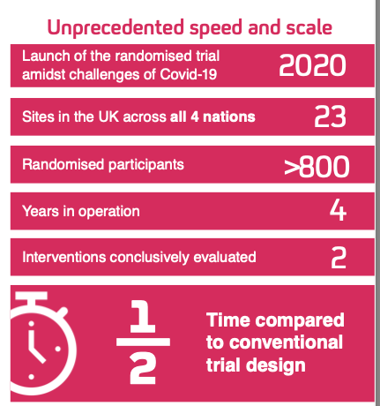
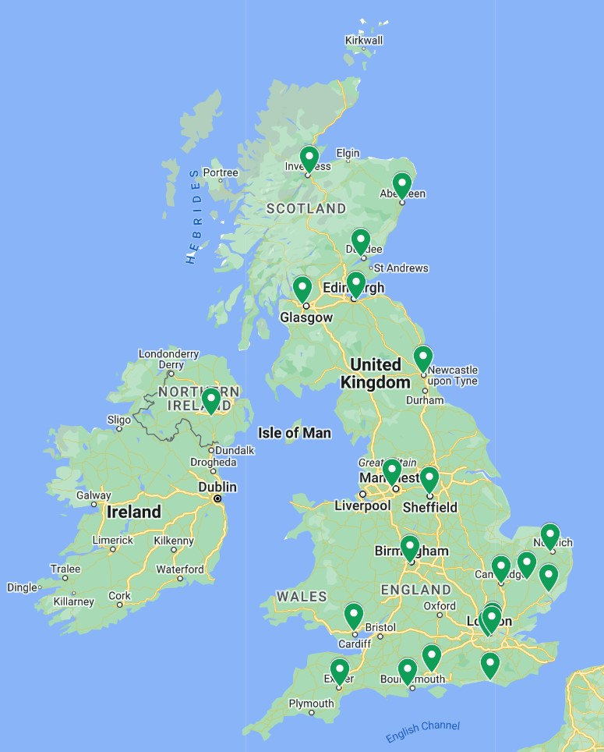
Recruitment rate of c.15 participants/month
We strive for equity of access for pwMND throughout the UK regardless of location, social status, or ethnicity

Slide 14
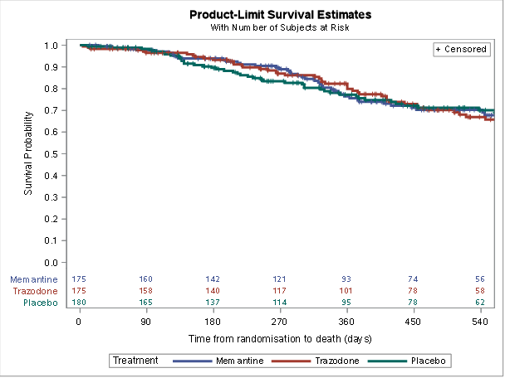
Definitive result for memantine and trazodone comparisons submitted to The Lancet Neurology

Slide 15
“Just the knowledge that there may be some help available, not a cure, but something that could ease the symptoms was encouraging. I'm not under any illusion that there is a cure at this moment in time, but I feel proud of myself and my husband for undertaking the Trial and proud I might be doing my bit in the fight against MND.”
Participant in Isle of Wight
“It’s given me such hope being in the trial, knowing we can help make this diagnosis a bit easier for people in the future is amazing.
I also get extra time speaking with the team who are great, it’s like another team are part of my care”
Participant in Ipswich
“I am so grateful to have the opportunity to take part in MND-SMART clinical trials. While I live in hope that I may have a 'miracle drug', I also feel strongly that the only way forward to lessening the impact of this condition is through research”
Participant in Orkney
“Knowing I could be helping people in the future is really important, it has given me the will and life to carry on each day.”
Participant in Salford

Slide 16
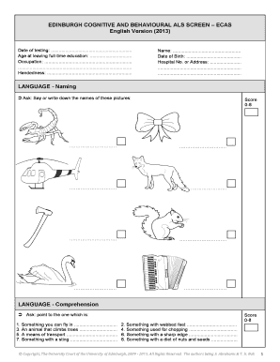
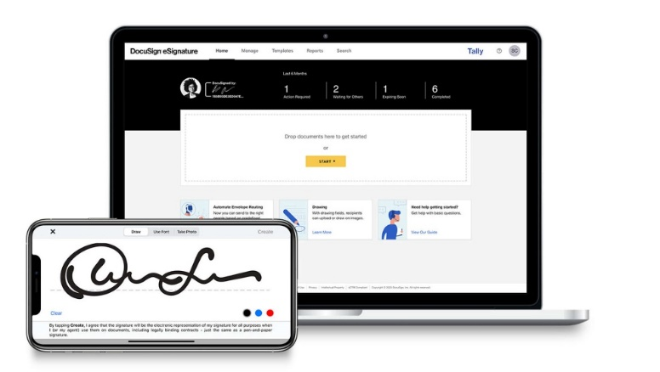
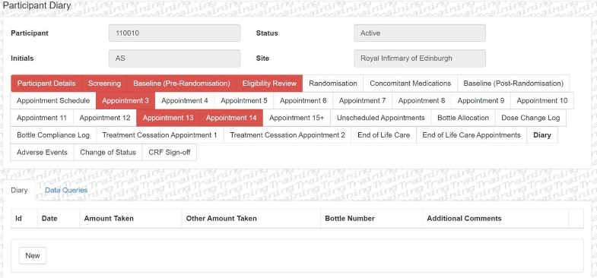
E-consenting
Video conference follow ups
Electronic diary cards
Remote ECAS
Continuous innovation supporting decentralisation

Slide 17
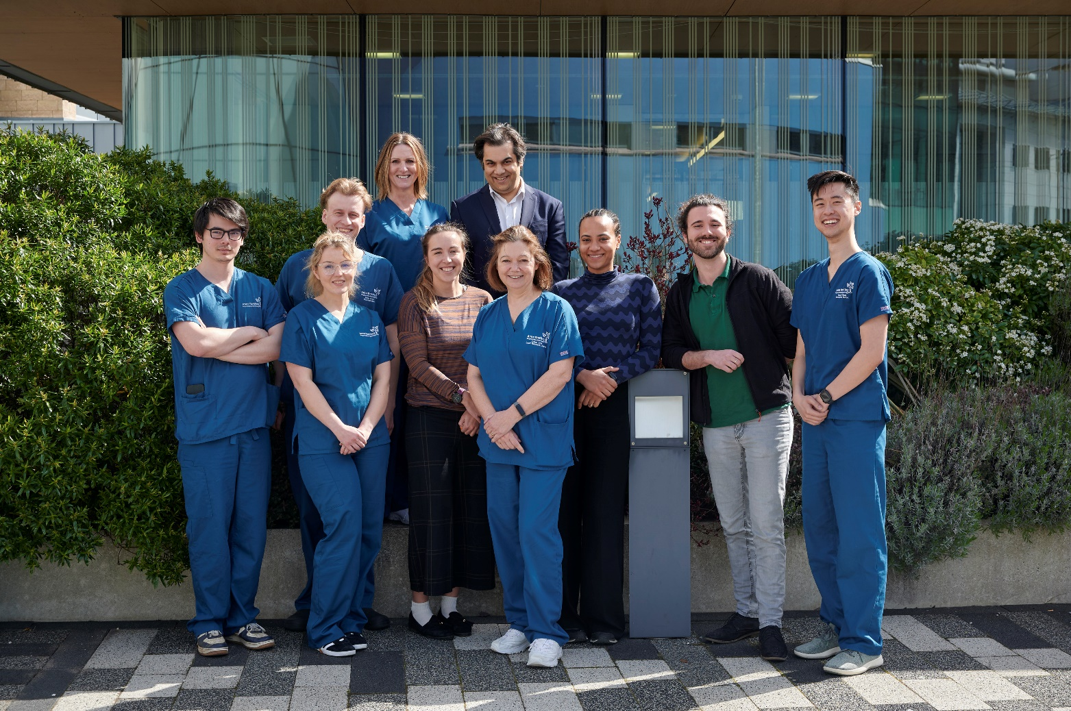
The Edinburgh MND Clinical Trials Centre has randomised 160 participants
Clinical Research Nurse Specialists:
Judy Newton, Dawn Lyle, Ethan Stoker, Isaac Chau
Clinical Research Fellows:
Sai Parepalli, Dominic Ng
Consultant Neurologists:
Suvankar Pal, Siddharthan Chandran, Hatice Kurucu-King

Slide 18
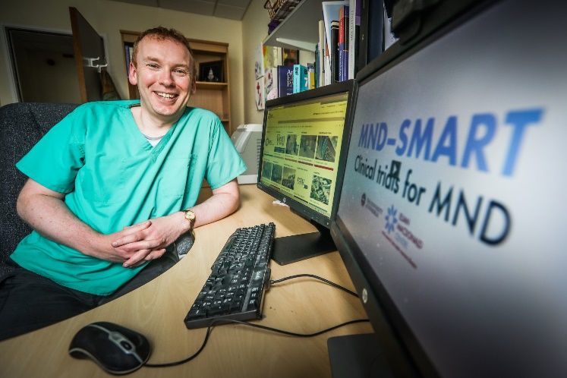
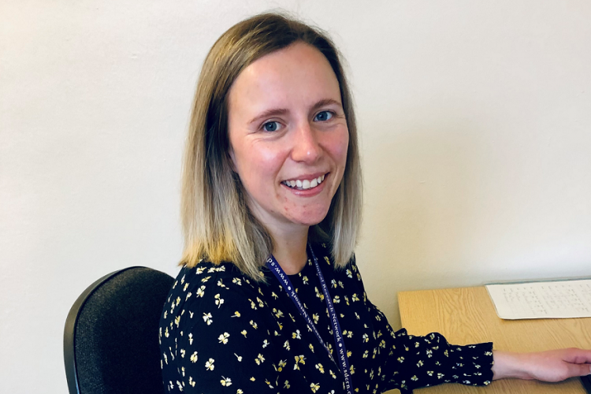
The Dundee team has recently celebrated the 50th patient randomised into the MND SMART trial
"MND SMART recruitment in Tayside is a real team effort! We are lucky to work alongside our wonderful MND specialist nurses, doctors and wider MDT. We are very grateful to our patients and their families who give up their precious time to take part in the study and we hope that our contribution will make a difference for the future in treating this cruel disease.”
Tiffany Stewart – Clinical Studies Officer
Neuroprogressive and Dementia Research Network, NHS Tayside

Slide 19
Site | Accrual
Aberdeen | 32
Dundee | 50
Edinburgh | 160
Glasgow | 40
Inverness | 21
TOTAL | 303

Slide 20
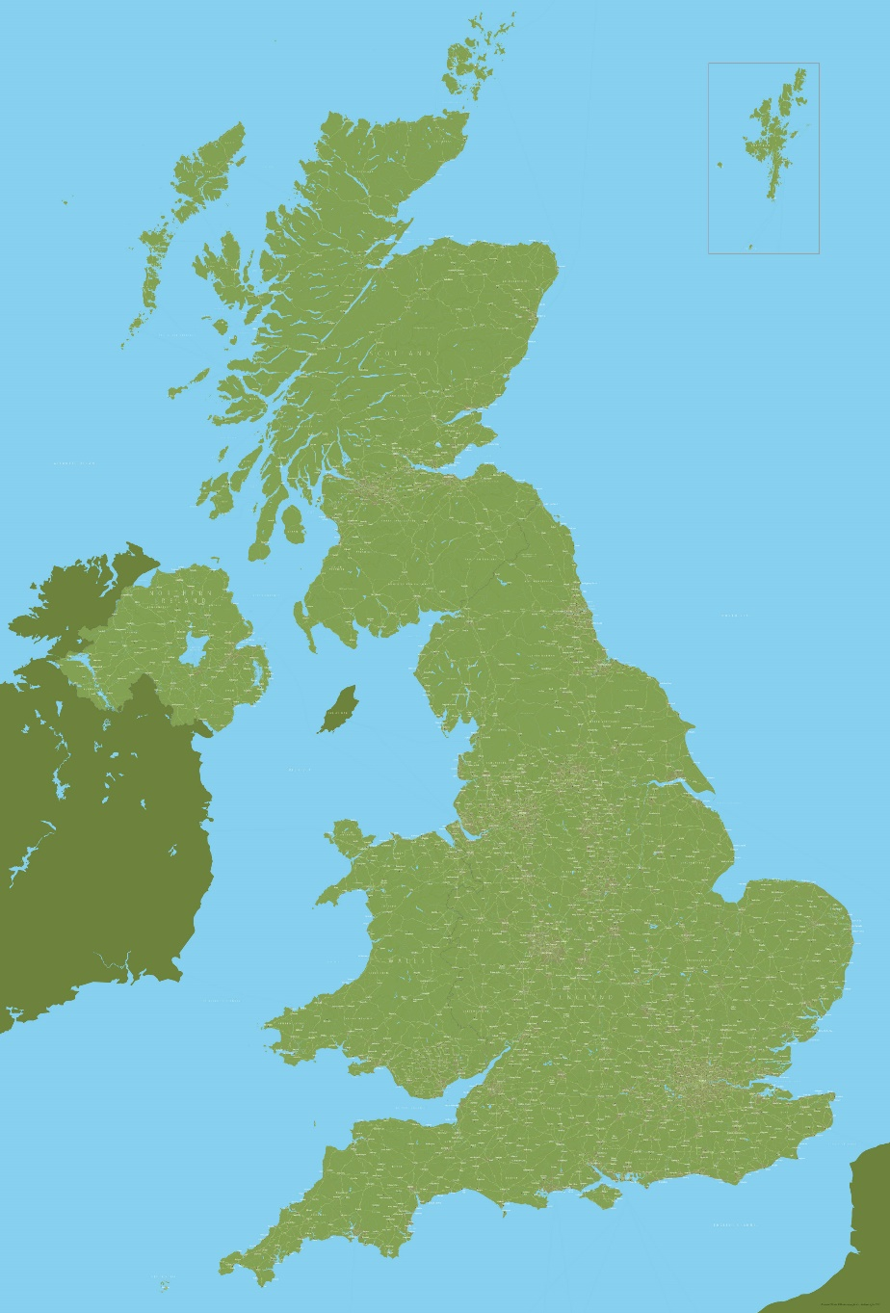
Increasing accessibility to remote areas Orkney and Shetland Isles
Aberdeen site is now able to recruit patients from these islands
“We are planning to do a baseline visit. How would it work for starting medication?” – member of Aberdeen research team
Innovative trial design features:
Use of an offshore company that provides shipments to remote Scottish islands within a day (weather permitting!)
Remote appointments completed by telephone/secure video calls
Use of Docusign, a web-based system for electronically signing documents, including re-consenting
Organisation of appointments at same time as PI clinics on islands

Slide 21
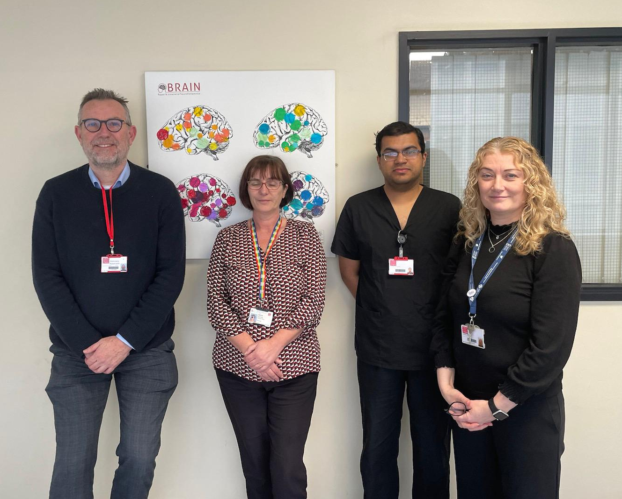
WALES: The Cardiff centre has recently celebrated the 50th patient randomised into the MND SMART trial
“We are grateful to the patients with MND and their families for putting themselves forward for this trial and they in turn have appreciated the opportunity to be part of this research project. We look forward to continuing to work in this trial and are promoting the study to our patient group.
My thanks also goes to the MND care coordinators throughout the South Wales MND Care and Research Network”
Dr K Dawson (Consultant Neurologist and Principal Investigator)

Slide 22
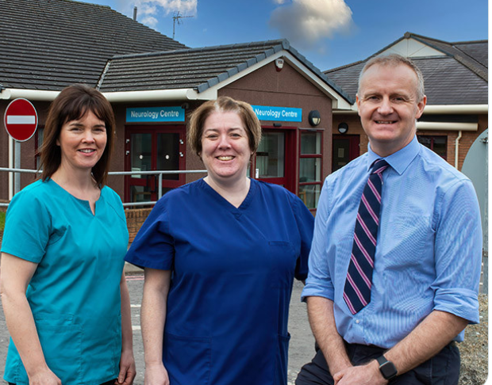
MND SMART has delivered the first clinical trials for MND in Northern Ireland
“MND SMART has opened the door to making trial participation part of routine care of MND in Northern Ireland and gives us all hope.
MND SMART has created the opportunity for people in Northern Ireland with MND to access trials. Not just now, but long into the future”
Dr Raeburn Forbes, Neurologist + PI, Craigavon, Northern Ireland

Slide 23
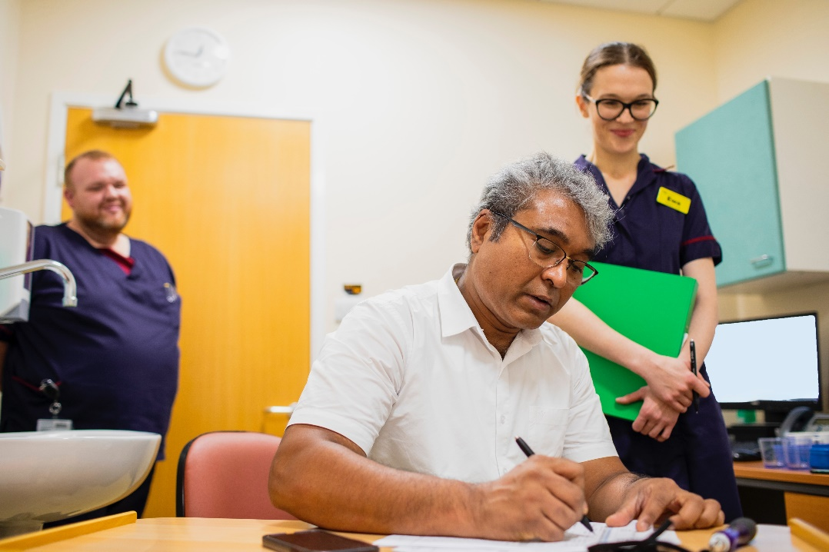
The Birmingham centre has recently celebrated the 50th patient randomised into the MND SMART trial
“Enrolling so far 52 patients has been a meaningful journey, and I feel deeply honoured to have met each patient and their families. I am grateful to every patient who is on the trial, who participated previously, and also to those who showed interest but couldn't join or are still waiting. I am hopeful that our collective efforts will contribute to finding a treatment. Thank you to everyone for their time, dedication, and support. Additionally, it is an absolute pleasure to work with the MND-SMART Trial Central Team, who are always very supportive and helpful.”
Ewa Delmaczynska (Lead research nurse, Birmingham)

Slide 24
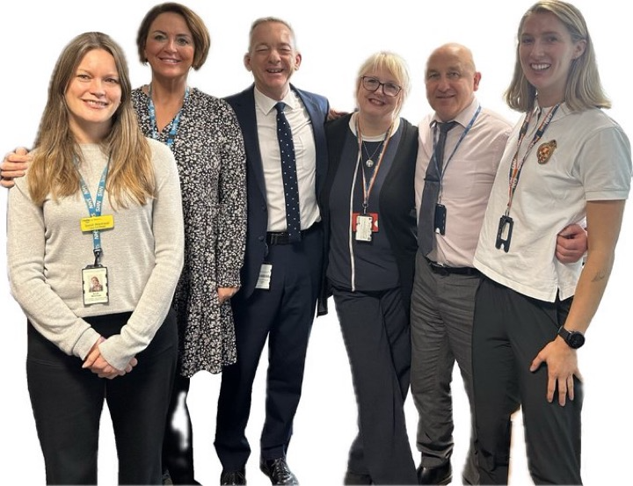
The Newcastle MND Care and Research Centre has recently celebrated the 50th patient randomised into the MND SMART trial
“We are hugely grateful to the Edinburgh MND-SMART team and sponsors for giving us the opportunity to support the trial in Newcastle and we wish to thank both the trial development, and Edinburgh delivery management teams for designing, producing and implementing such a deliverable project”
Andy Hamilton (Lead Research Nurse, Newcastle)

Slide 25
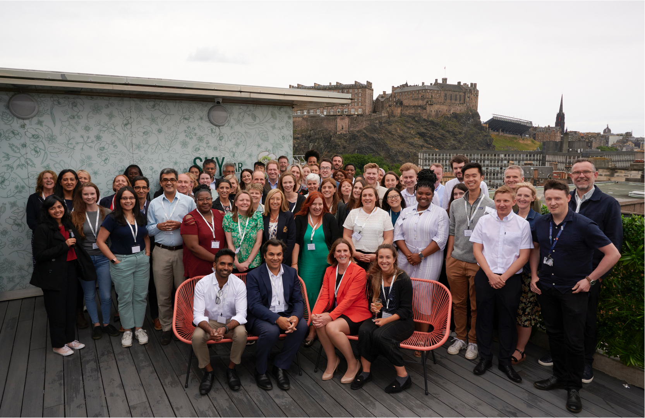
A UK wide inter-disciplinary partnership of experts in MND disease biology, stem cells,
drug discovery, innovative trial methodology, & people living with MND

Slide 26
“The plan to introduce new drugs for testing in MND SMART opens up a new avenue of hope for all of us. Unless we try new things we are stuck in the same place.”
PPIE group member, November 2023

Slide 27


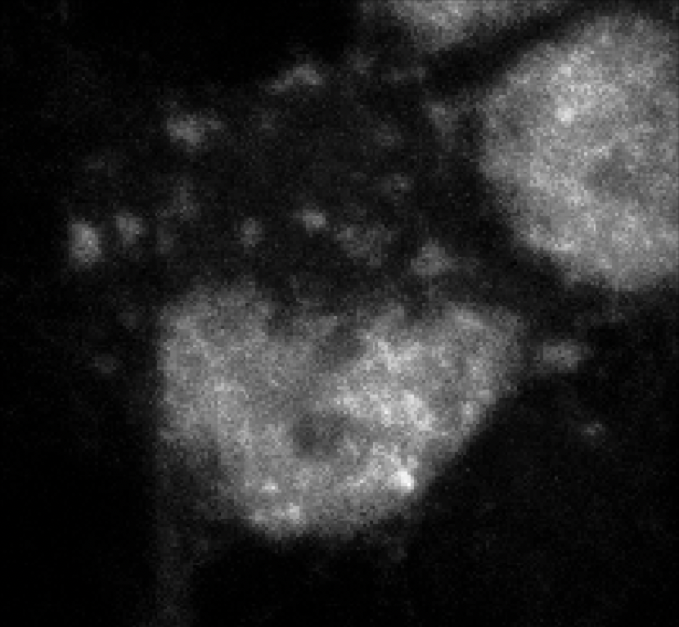

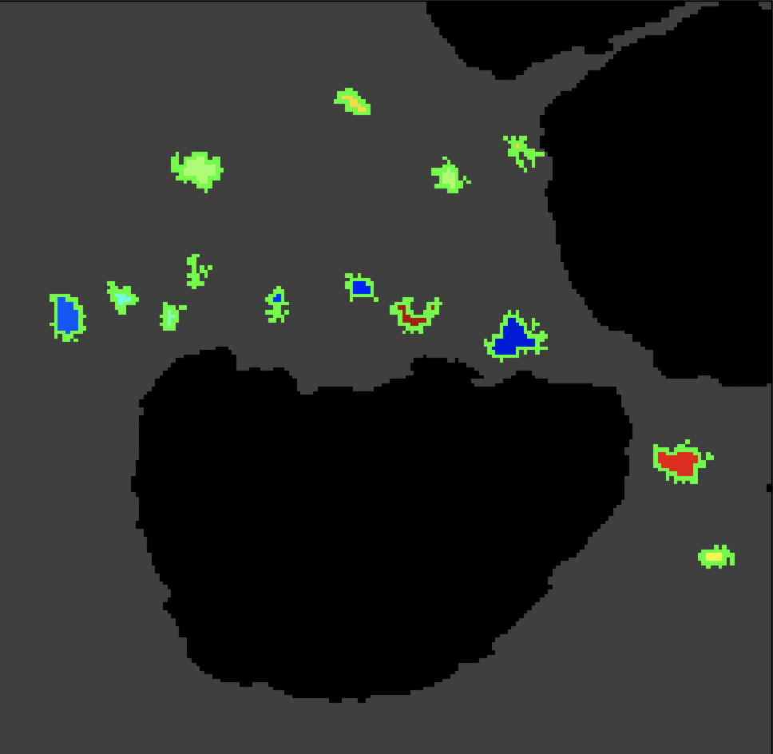
A new era in drug discovery
1. Cells are plated in 384 well plates for screening
2. Drug treatment
6652 small molecules, 1 dose, 3 replicates
3. Automated image segmentation and analysis
4. ‘Hit’ identification
 | 1 | 2 | 3 | 4 | 5 | 6 | 7 | 8 | 9 | 10 | 11 | 12 | 13 | 14 | 15 | 16 | 17 | 18 | 19 | 20 | 21 | 22 | 23 | 24
A
B
C
D
E
F
G
H
I
J
K
L
M
N
O
P
protein
aggregate
image
negative control
drug
positive control
segmentation
active drug
High throughput drug screening
TDP43 aggregation
Motor neuron excitotoxicity
Astrocyte reactivity
Astrocyte anti-oxidant
Microglial inflammation
In-silico AI/ML driven drug selection
RelysR-MND systematic review
In-silico drug repurposing
Animal models
TDP-43 mouse models
Zebrafish models

Slide 28
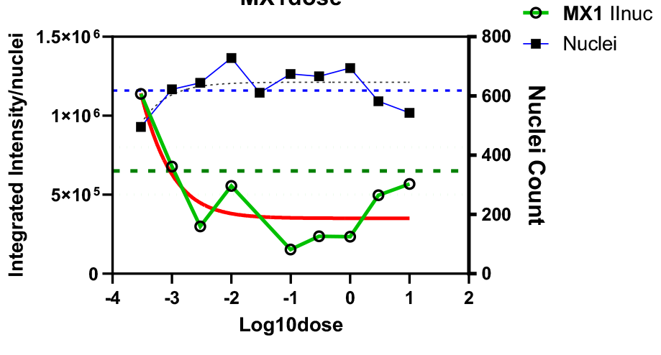
A new era in drug discovery
tacrolimus (calcineurin – mTOR inhibitor), and baricitinib (JAK/STAT3 inhibitor) - compelling data from human discovery platforms.
Challenges for protocol amendments to accommodate these include:
  screening criteria, routes of administration, dose schedules, safety monitoring.
Combination therapies may also show promise.
Reduces TDP43 aggregates
Dampens astrocyte reactivity
Dampens astrocyte reactivity
JAK/STAT3 inhibitors (baricitinib)
Calcineurin /mTOR inhibitors (tacrolimus)

Slide 29
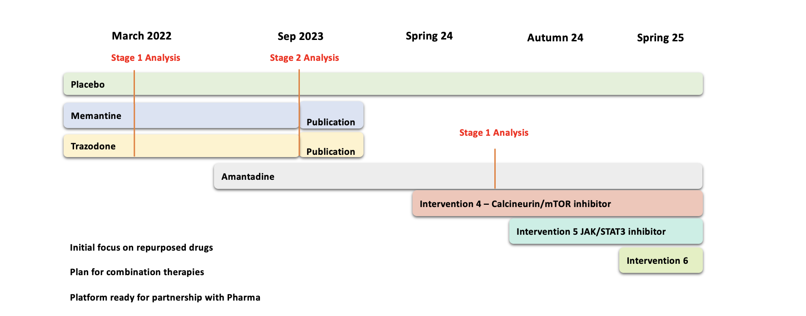
MND SMART – A platform for reverse translation
Comprehensive longitudinal phenotyping High level of completeness & data integrity
Linked bio-resourcing DNA/serum/plasma/PMBC, digital, autopsy
Digital data

Slide 30
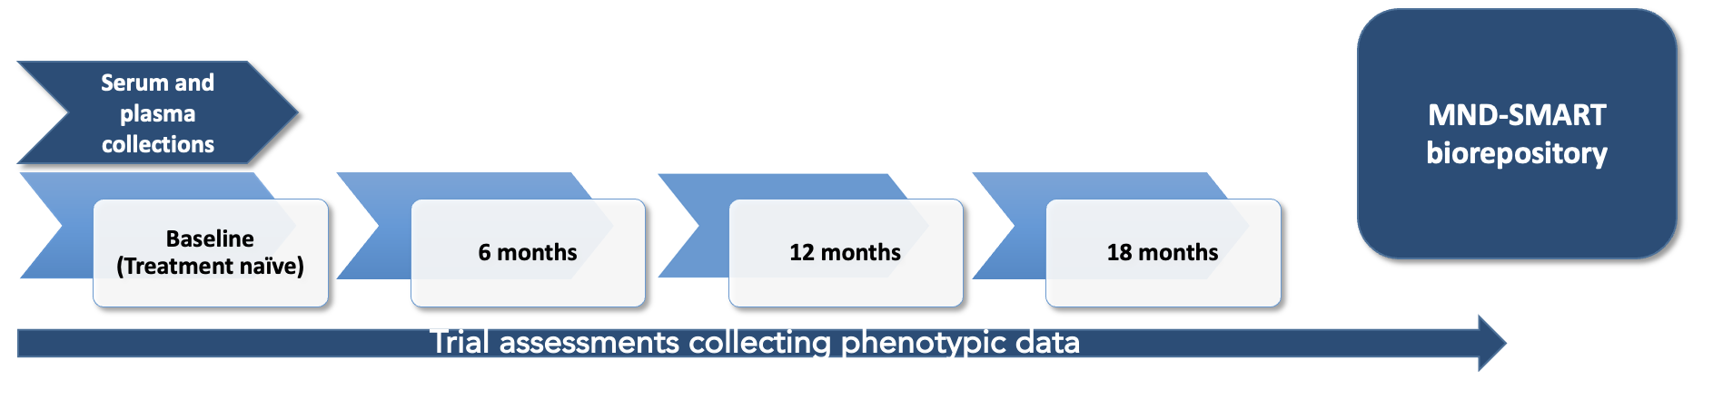
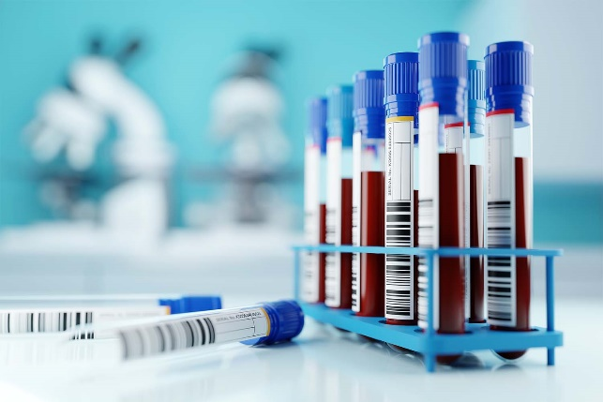
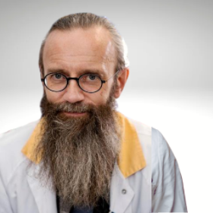
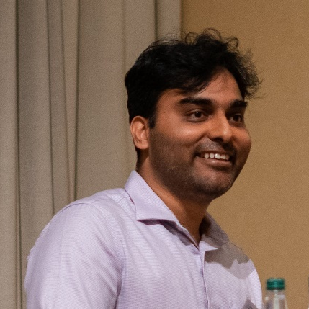
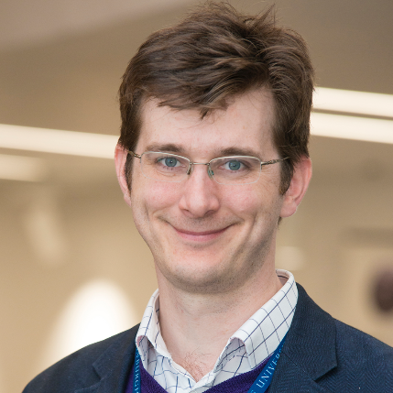
MND SMART – A platform for reverse translation

Slide 31




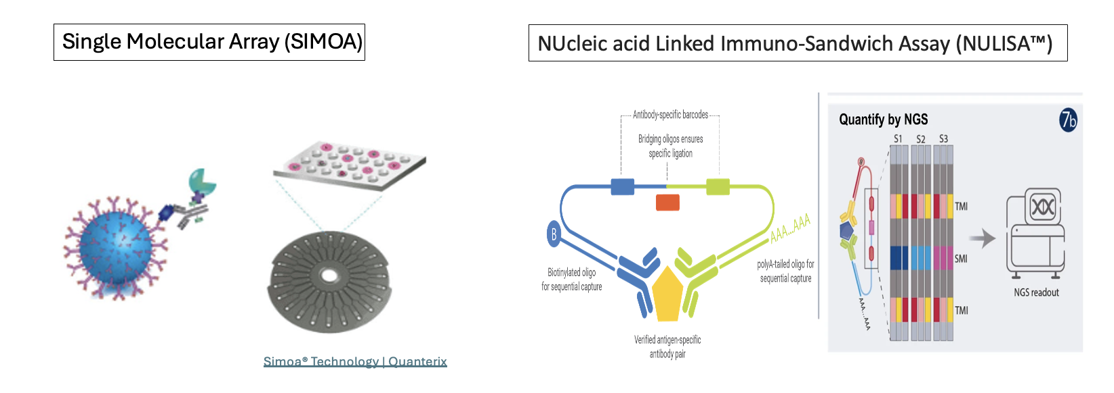
Fostering national/international collaborations
Platforms supporting integrated care & reverse translation

Slide 32

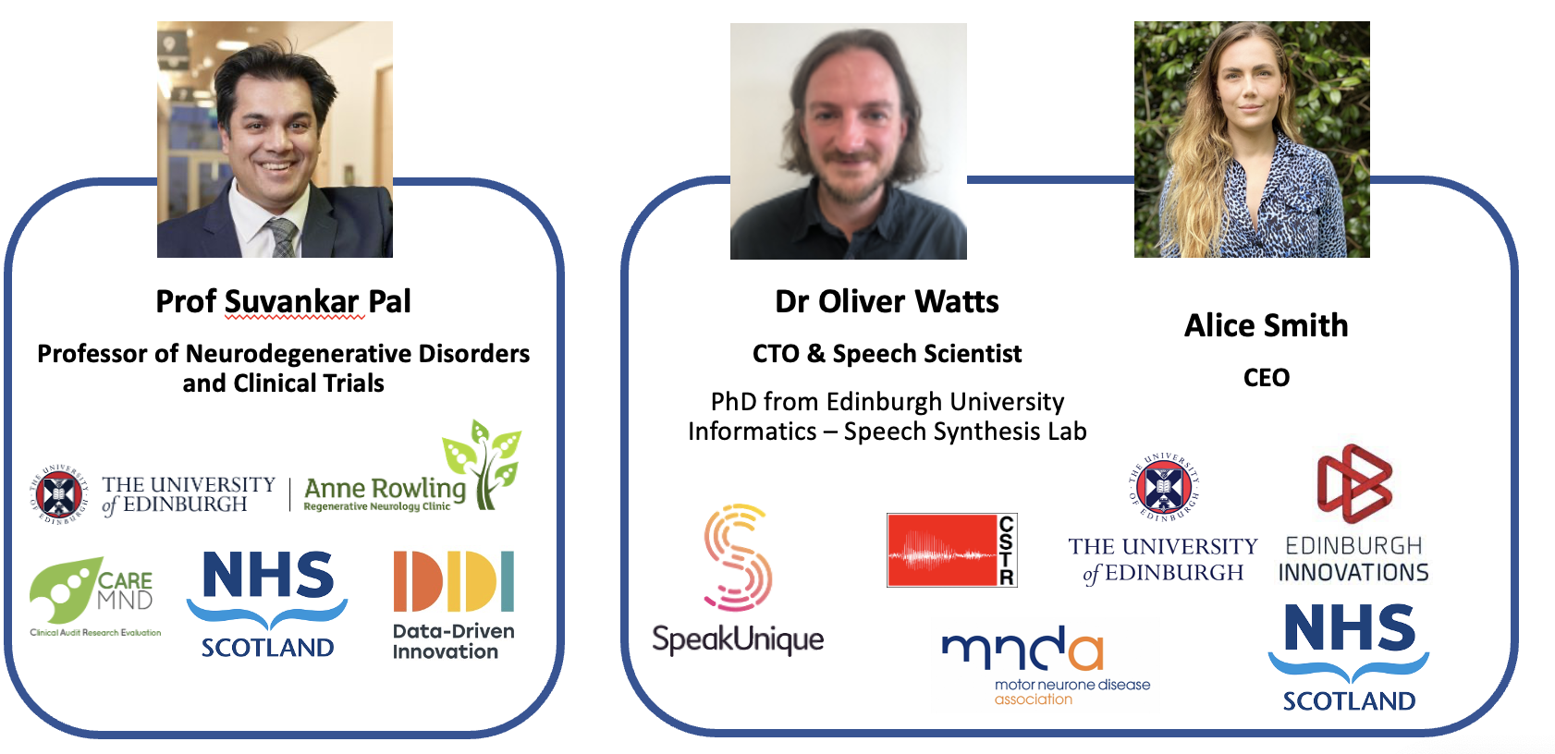
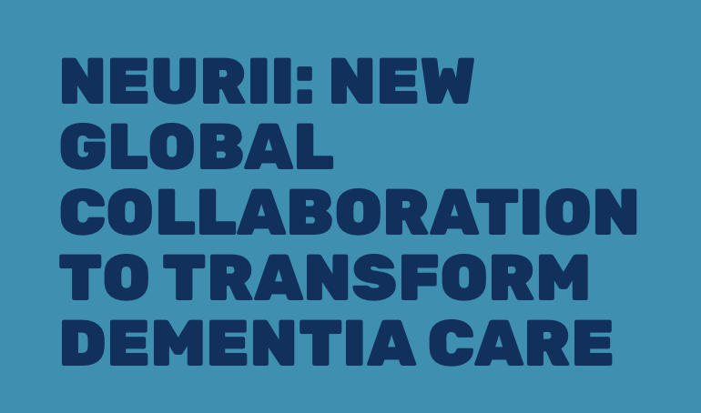
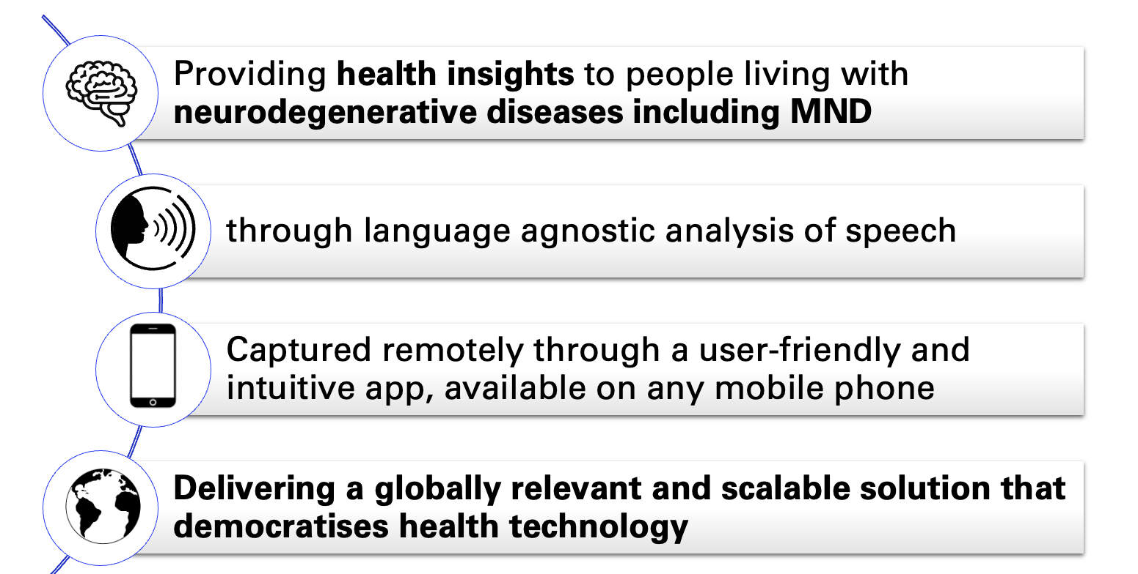
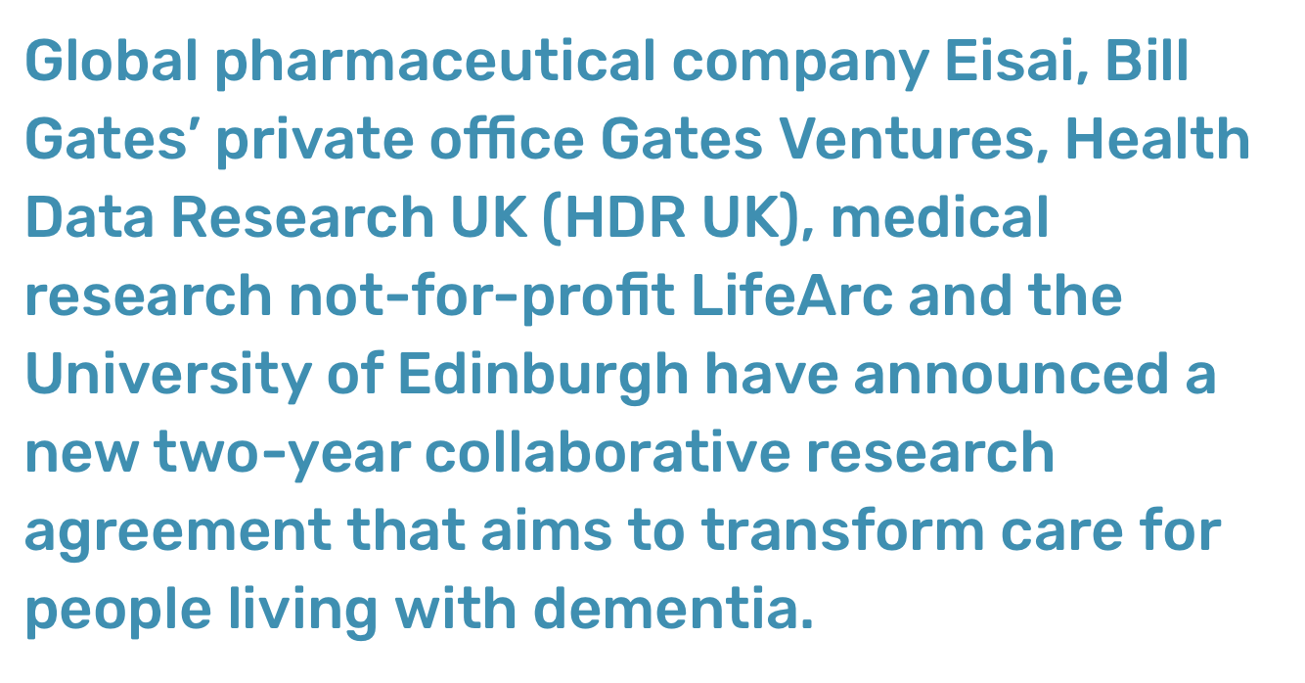

Slide 33



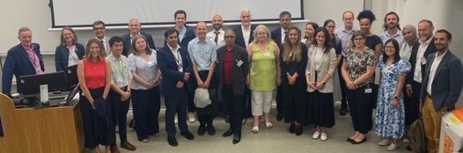
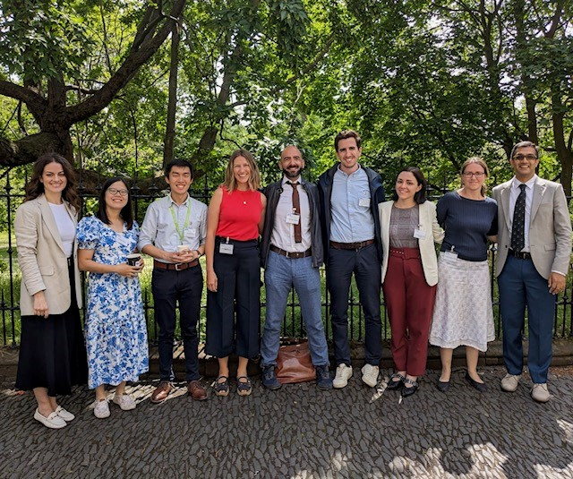
The National ACORD collaboration
The national ACORD collaboration supports the development, running and reporting of Multi-arm, Multi-stage Platform Trials in: MND, Progressive MS, Parkinson’s Disease and ultimately Dementia.

Slide 34









The future – close partnership with funding partners

Slide 35

Stage 1 interim analysis for amantadine Summer 24
Platform ready for collaboration with Pharma

Slide 36
MND SMART - Delivering definitive results
MND SMART has delivered definitive results for separate interventions 3.5y after launch
Highly efficient: time, participant, & financial resource, including successful rapid recruitment despite the COVID-19 pandemic
MND SMART has delivered UK national infrastructure & training
Enabling a new treatment arm, amantadine, to be launched in April 2023, and a 4th treatment arm in Summer 24
Pre-specified interim analyses successfully guided early stopping of ineffective interventions
Close working with our PPIE group
Enabling high rates of recruitment & retention + clear communication plans e.g. when interventions were stopped
A large and well characterised bioresource supporting reverse translation
Supporting national/international collaborations

Slide 37
Acknowledgements
Trial Management group
Siddharthan Chandran, Director Edinburgh Neuroscience
Suvankar Pal, Professor of Neurodegenerative Disorders & Clinical Trials
Chris Weir, Professor of Medical Statistics and Clinical Trials
Judy Newton, MND National Lead Consultant Nurse
Amy Stenson, MND SMART Trial manager
Kenton D’Mellow, Data Manager
Dawn Lyle, Research Coordinator
Key Collaborators
Mahesh Parmar, Professor of Medical Statistics and Epidemiology, Director of MRC Clinical Trials Unit at UCL
James Carpenter, Professor of Medical Statistics, MRC Clinical Trials Unit at UCL
Jeremy Chataway, Professor of Neurology, University College London
Nigel Stallard, Professor of Medical Statistics, University of Warwick
Malcolm Macleod, Professor of Neurology and Translational Neuroscience, University of Edinburgh
Dr Robert Swingler, Consultant Neurologist
Trial Committees
Trial steering committee - Helen Ford (Chair)
Independent Data Monitoring Committee -Steve Wroe (Chair)
Trial Sponsors
ACCORD – NHS Lothian and University of Edinburgh
Funders:
Euan MacDonald Centre
MND Scotland
My Name’5 Doddie Foundation
MNDA
Alan Davidson Foundation
LifeArc
Site teams
Edinburgh - Suvankar Pal
Dundee - Ian Morrison
Glasgow – George Gorrie
Salford – Hisham Hamdalla
Aberdeen – Callum Duncan
Craigavon - Raeburn Forbes
Inverness – Javier Carod Artal
Exeter – Tim Harrower
St George’s – Pablo Garcia-Reitboeck
W Suffolk – Francesca Crawley
Birmingham – Venkat Srinivasan
Ipswich – Clare Galton
Newcastle – Tim Williams
Cardiff – Ken Dawson
Royal London – Aleks Radunovic
Southampton – Ashwin Pinto
Cambridge – Rhys Roberts
Norfolk – Godwin Mamutse
Poole – Charles Hillier
Sheffield – Chris McDermott
Kings – Ammar Al-Chalabi
Brighton – Andrew Barritt

Slide 38




Acknowledgements
MND-SMART Participants
Patient & Public Involvement group

Slide 39


Follow our updates on our website and Twitter/X
www.mnd-smart.org
@mndsmart @suvankarpal @jNewton_MND

